Slide 1
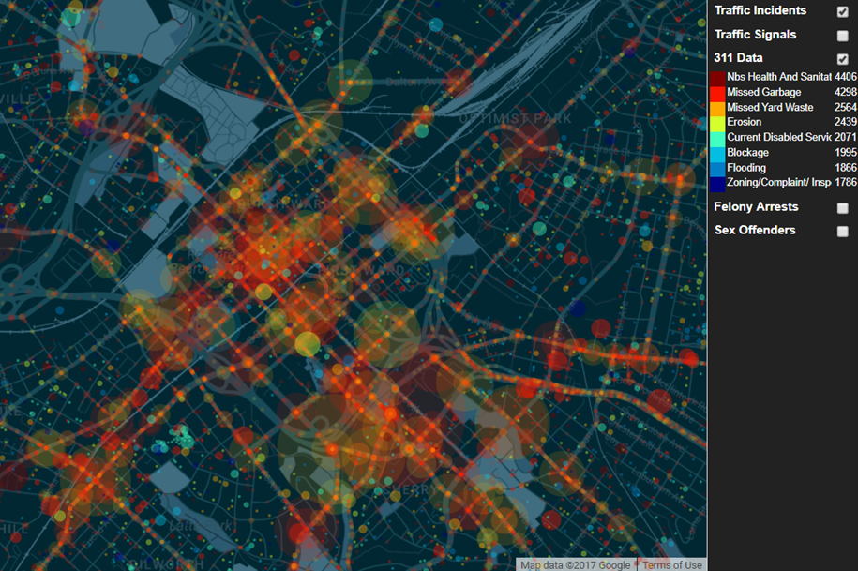
QC Hot Map
10,000 foot view of the city
Useful for city planners, law enforcement, and current & future residents.
Helps identify spatial patterns and anomalies.
Can be modified for real time monitoring, if the data can be collected.
TEAM: QC One Hot

Slide 2
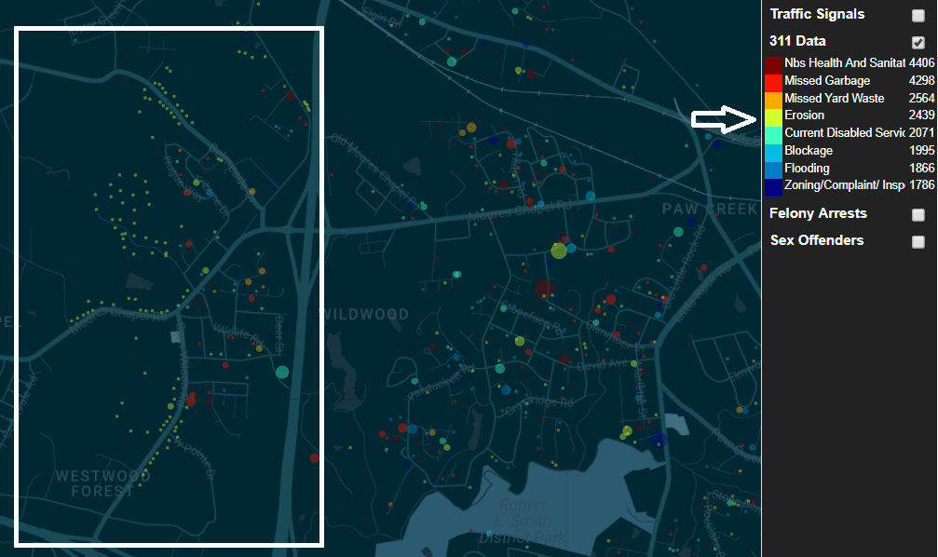
Identify neglected areas at a glance
Humans are the best at recognizing patterns.
We located a section of the city that is suffering from heavy erosion and we weren’t even looking for it.
I probably won’t buy a house there. That’s a good thing though! I’ll buy somewhere else and not have my home destroyed.

Slide 3
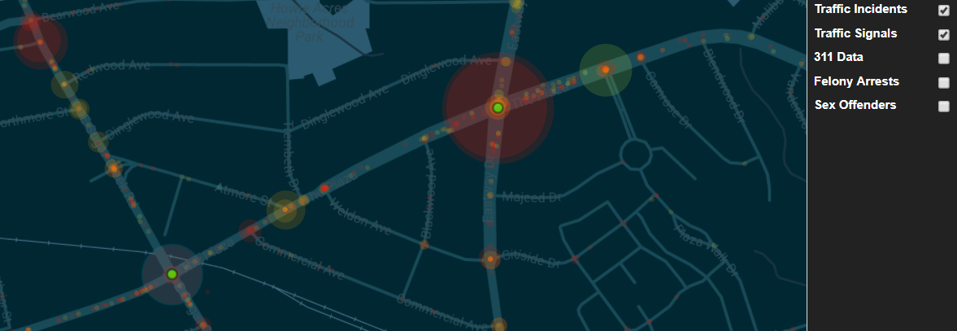
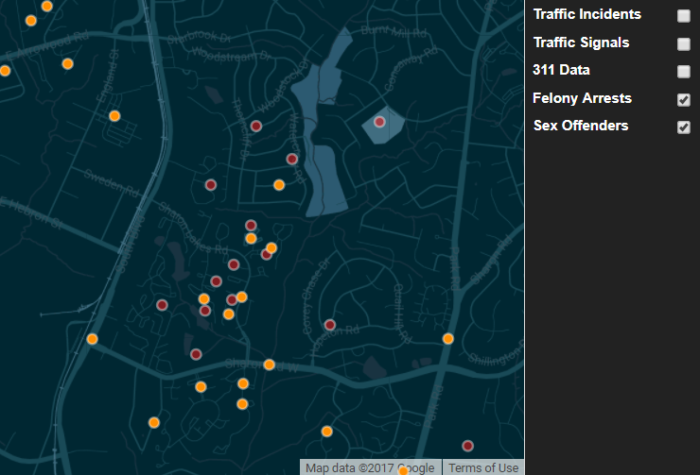
Traffic and Crime risk evaluation
Locate dangerous intersections that should probably have stoplights.
Traffic signal location provided by clt-charlotte.opendata.arcgis.com and overlain on the provided traffic incident data.
Identify hot spots of criminal activity, so police presence can be increased there.
Here you see combination of felony data from the provided arrest records and sex offender data from familywatchdog.com.

